Slide 1

DCM T4: Surveys & Blood Biomarkers
Anthony Campitelli

Slide 2


Analyses and Groupings
All conducted at 3-way level (group*sex*time)
Groupings for each variable:
Pooled
Score Quartiles
Cognition Quartiles (RBANS Total)
Older Adults (Age >= 60)
Younger Adults (Age < 60)
Other Analyses:
Group*quartile*time
Group*age(old/young)*time

Slide 3
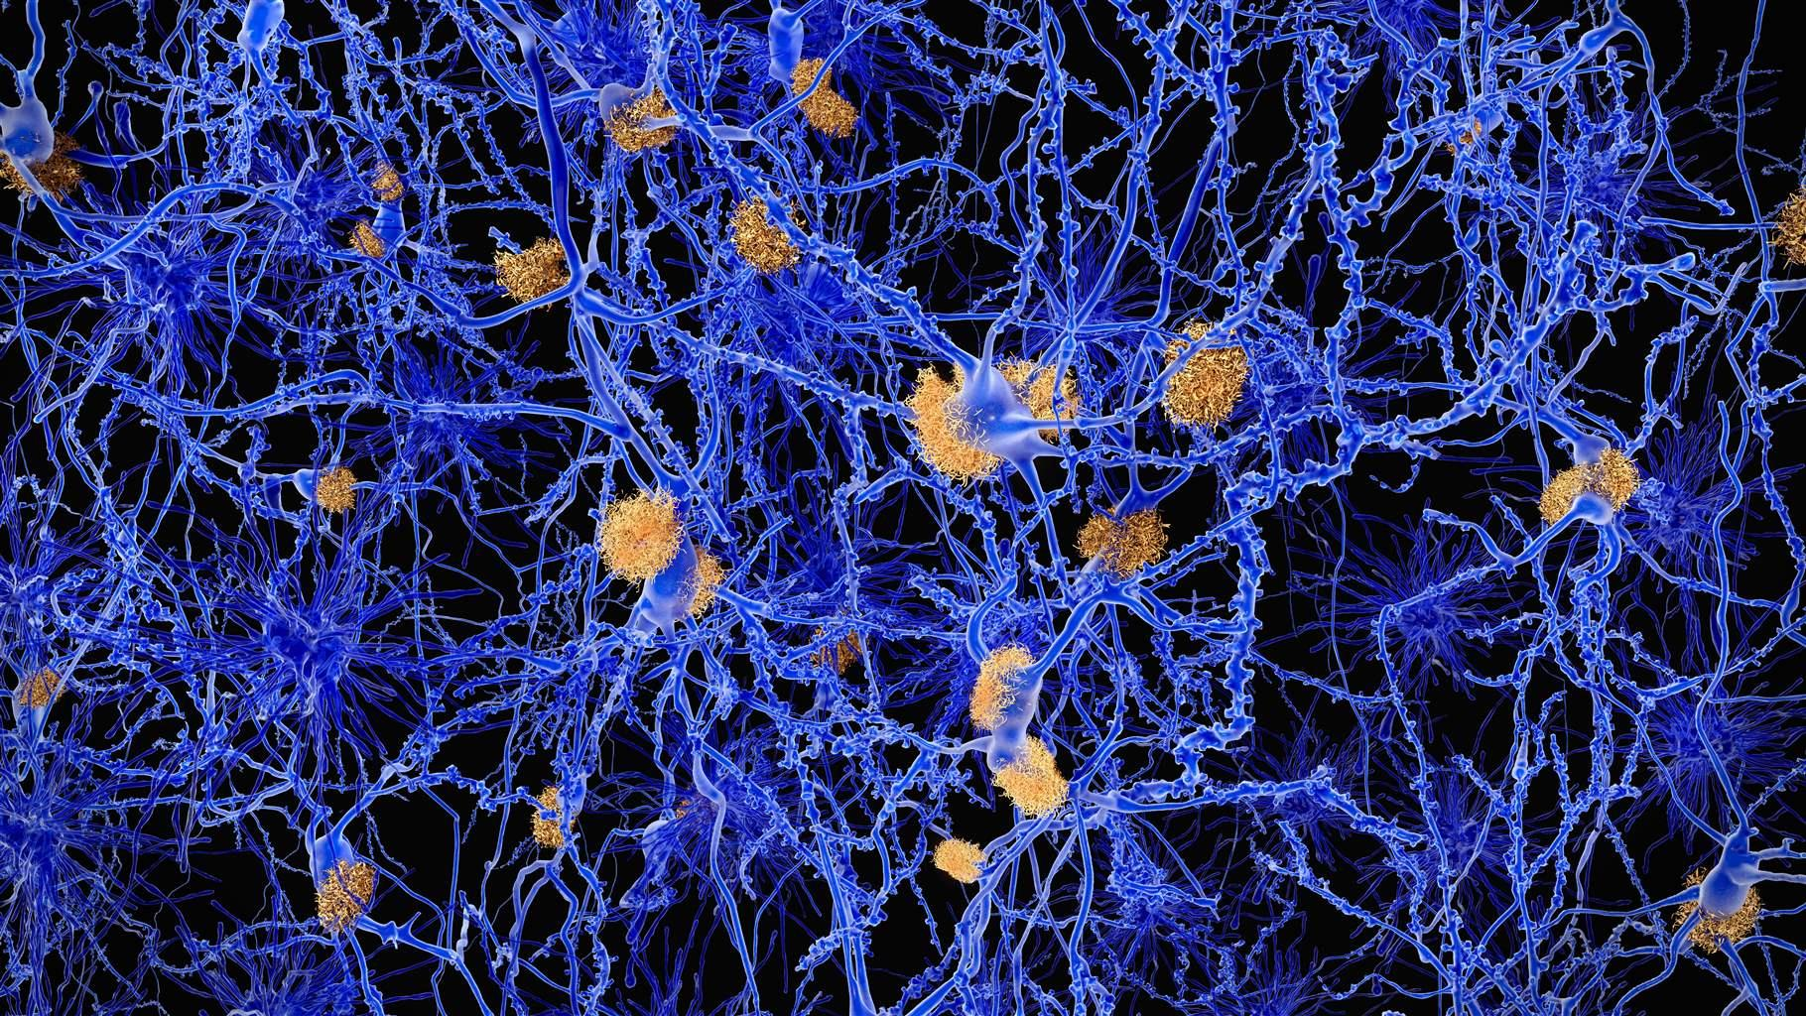
ANU-ADRI
Summary:
Risk increased over time
Protective score improved until T3 in HC, then regressed to the mean
Same results for older/younger adults
Examining Q1 and Q4 demonstrates score changes over time, but they are mostly expected/unremarkable

Slide 4
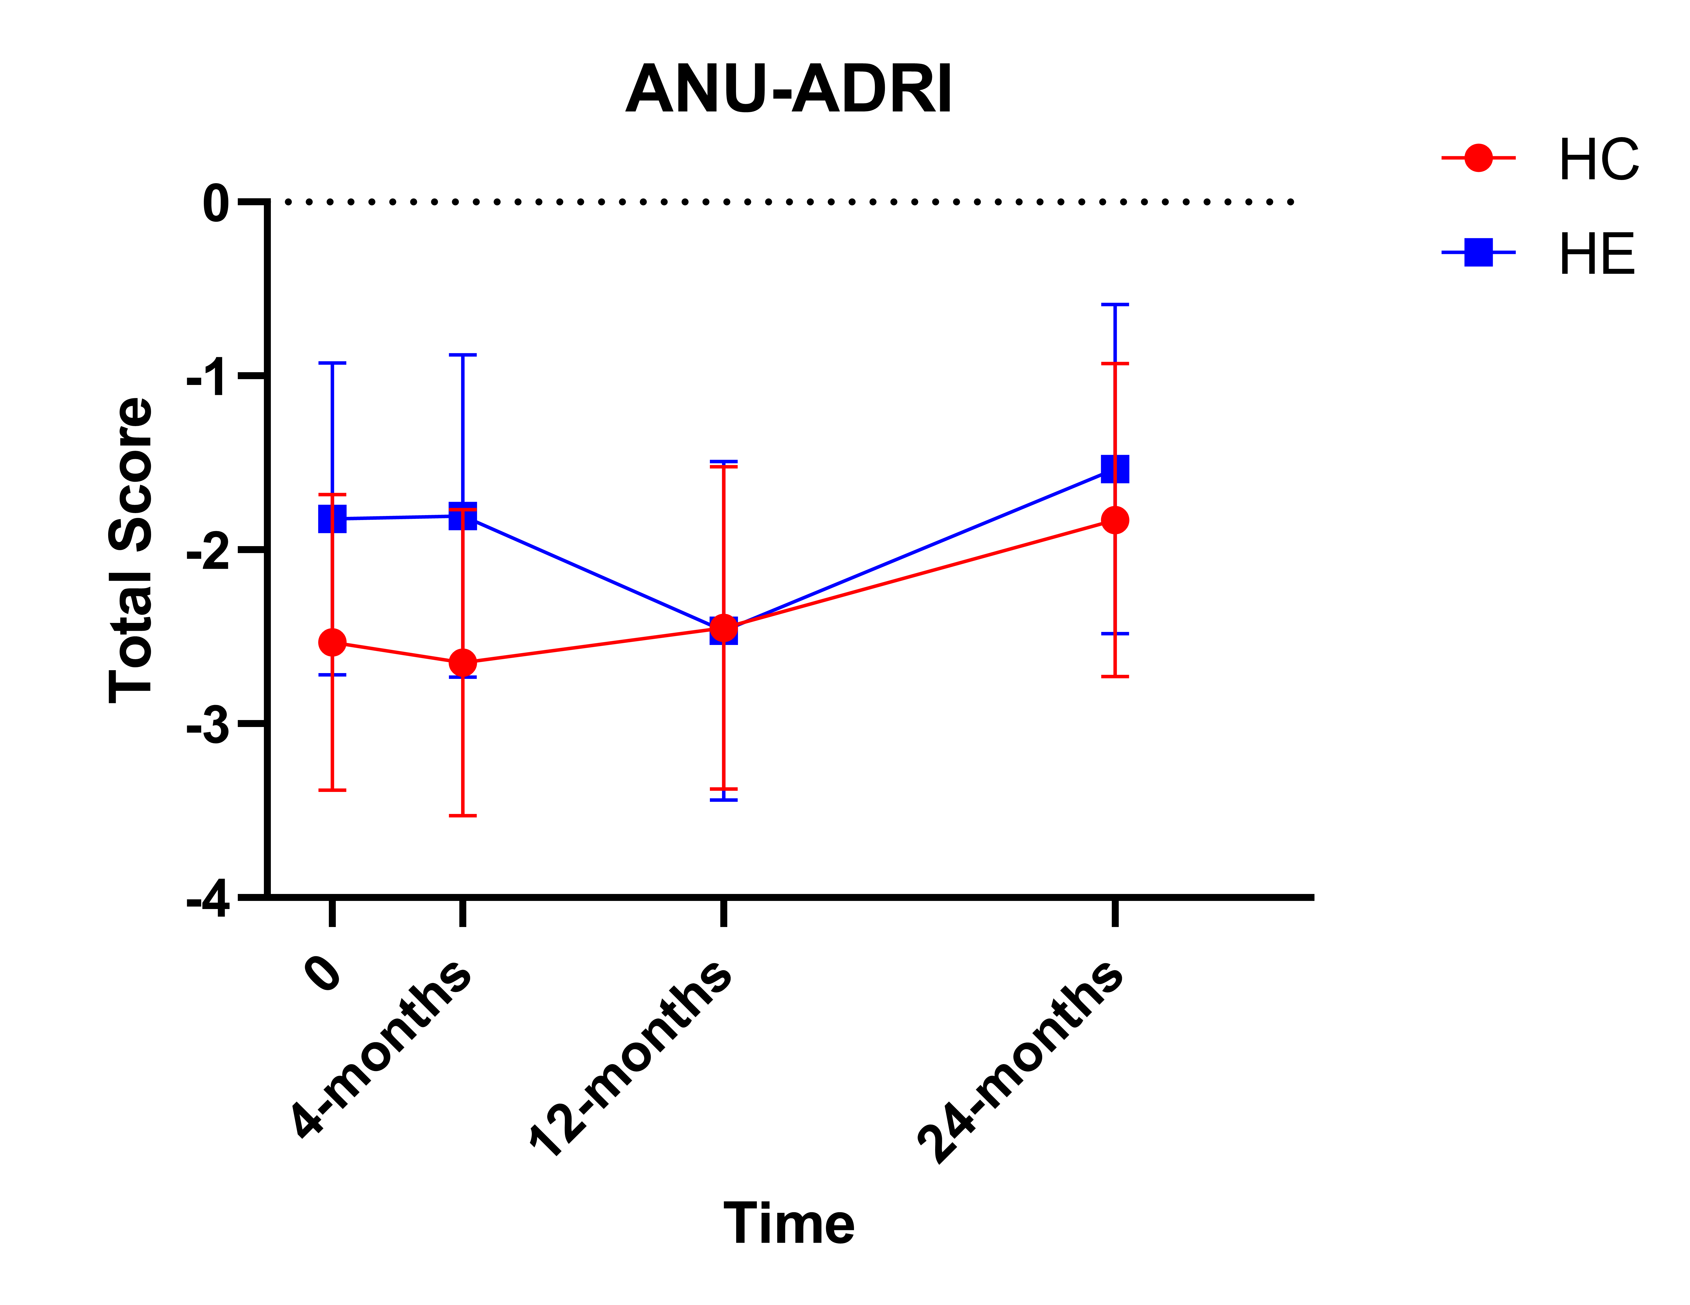
ANU-ADRI Total Score

Slide 5
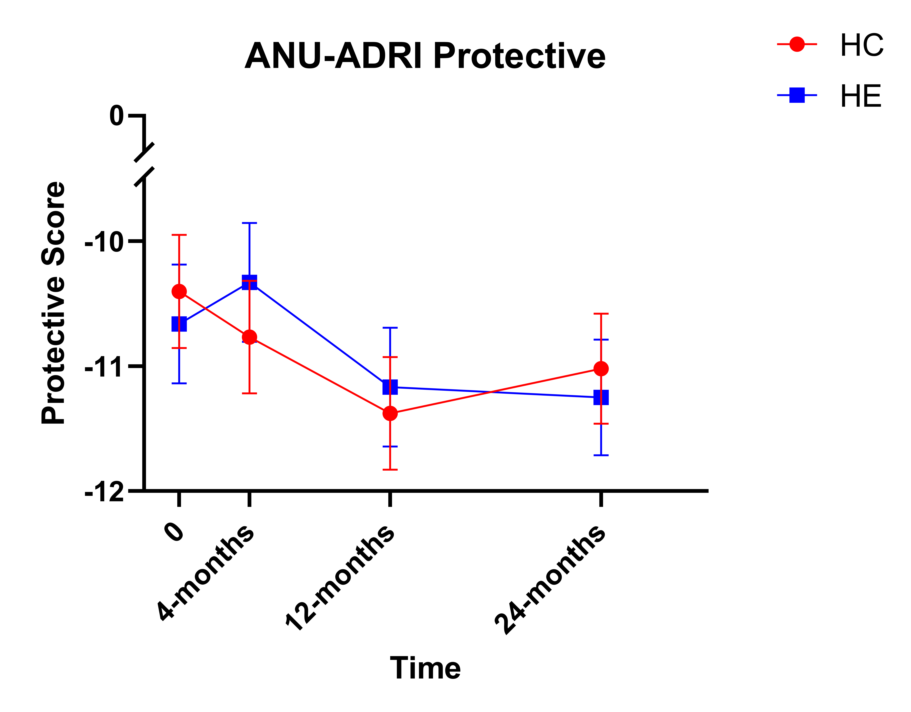
ANU-ADRI Protective Score
HC*

Slide 6
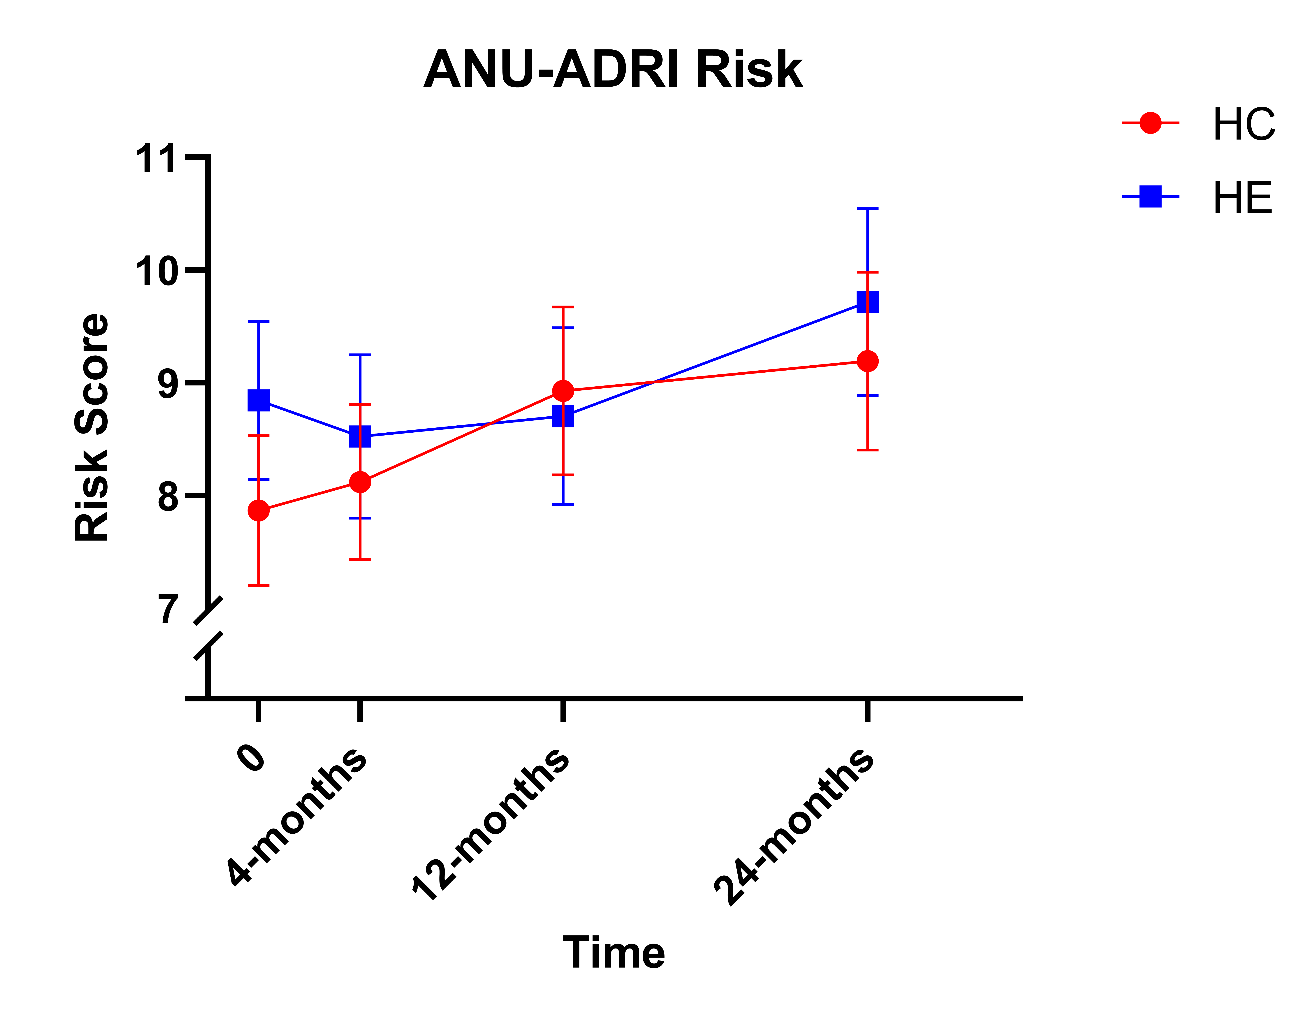
ANU-ADRI Risk Score
*

Slide 7
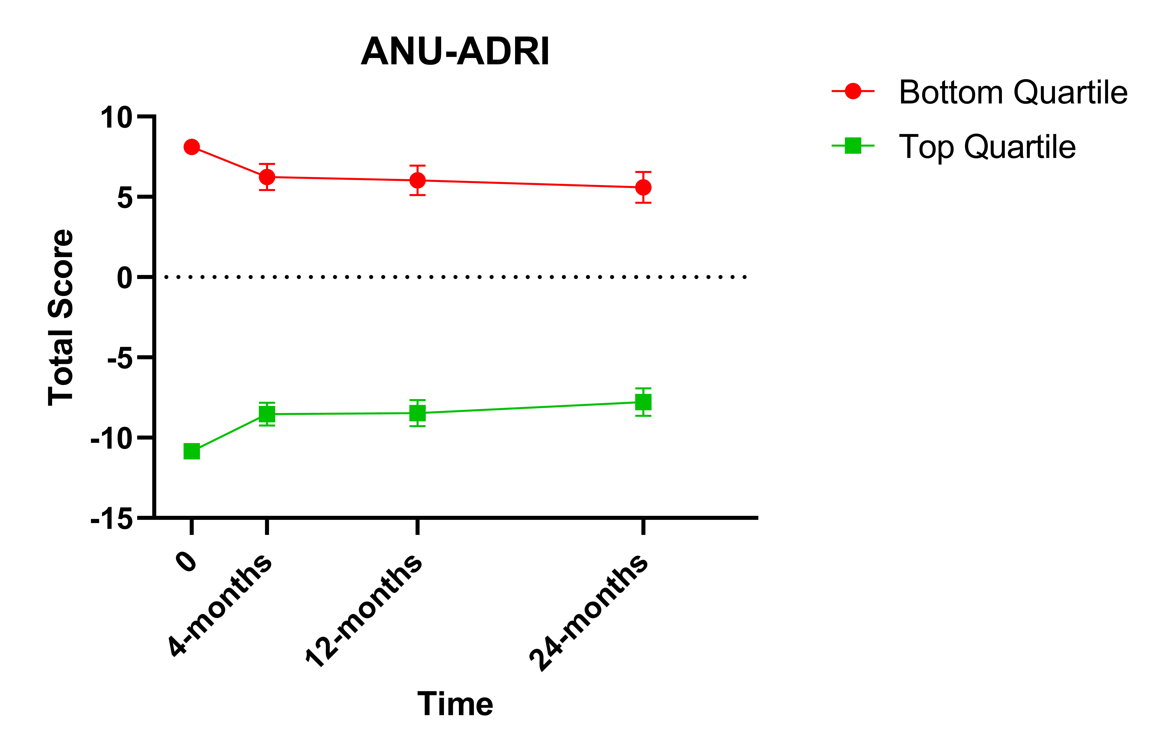
ANU-ADRI by Quartile
*
*

Slide 8
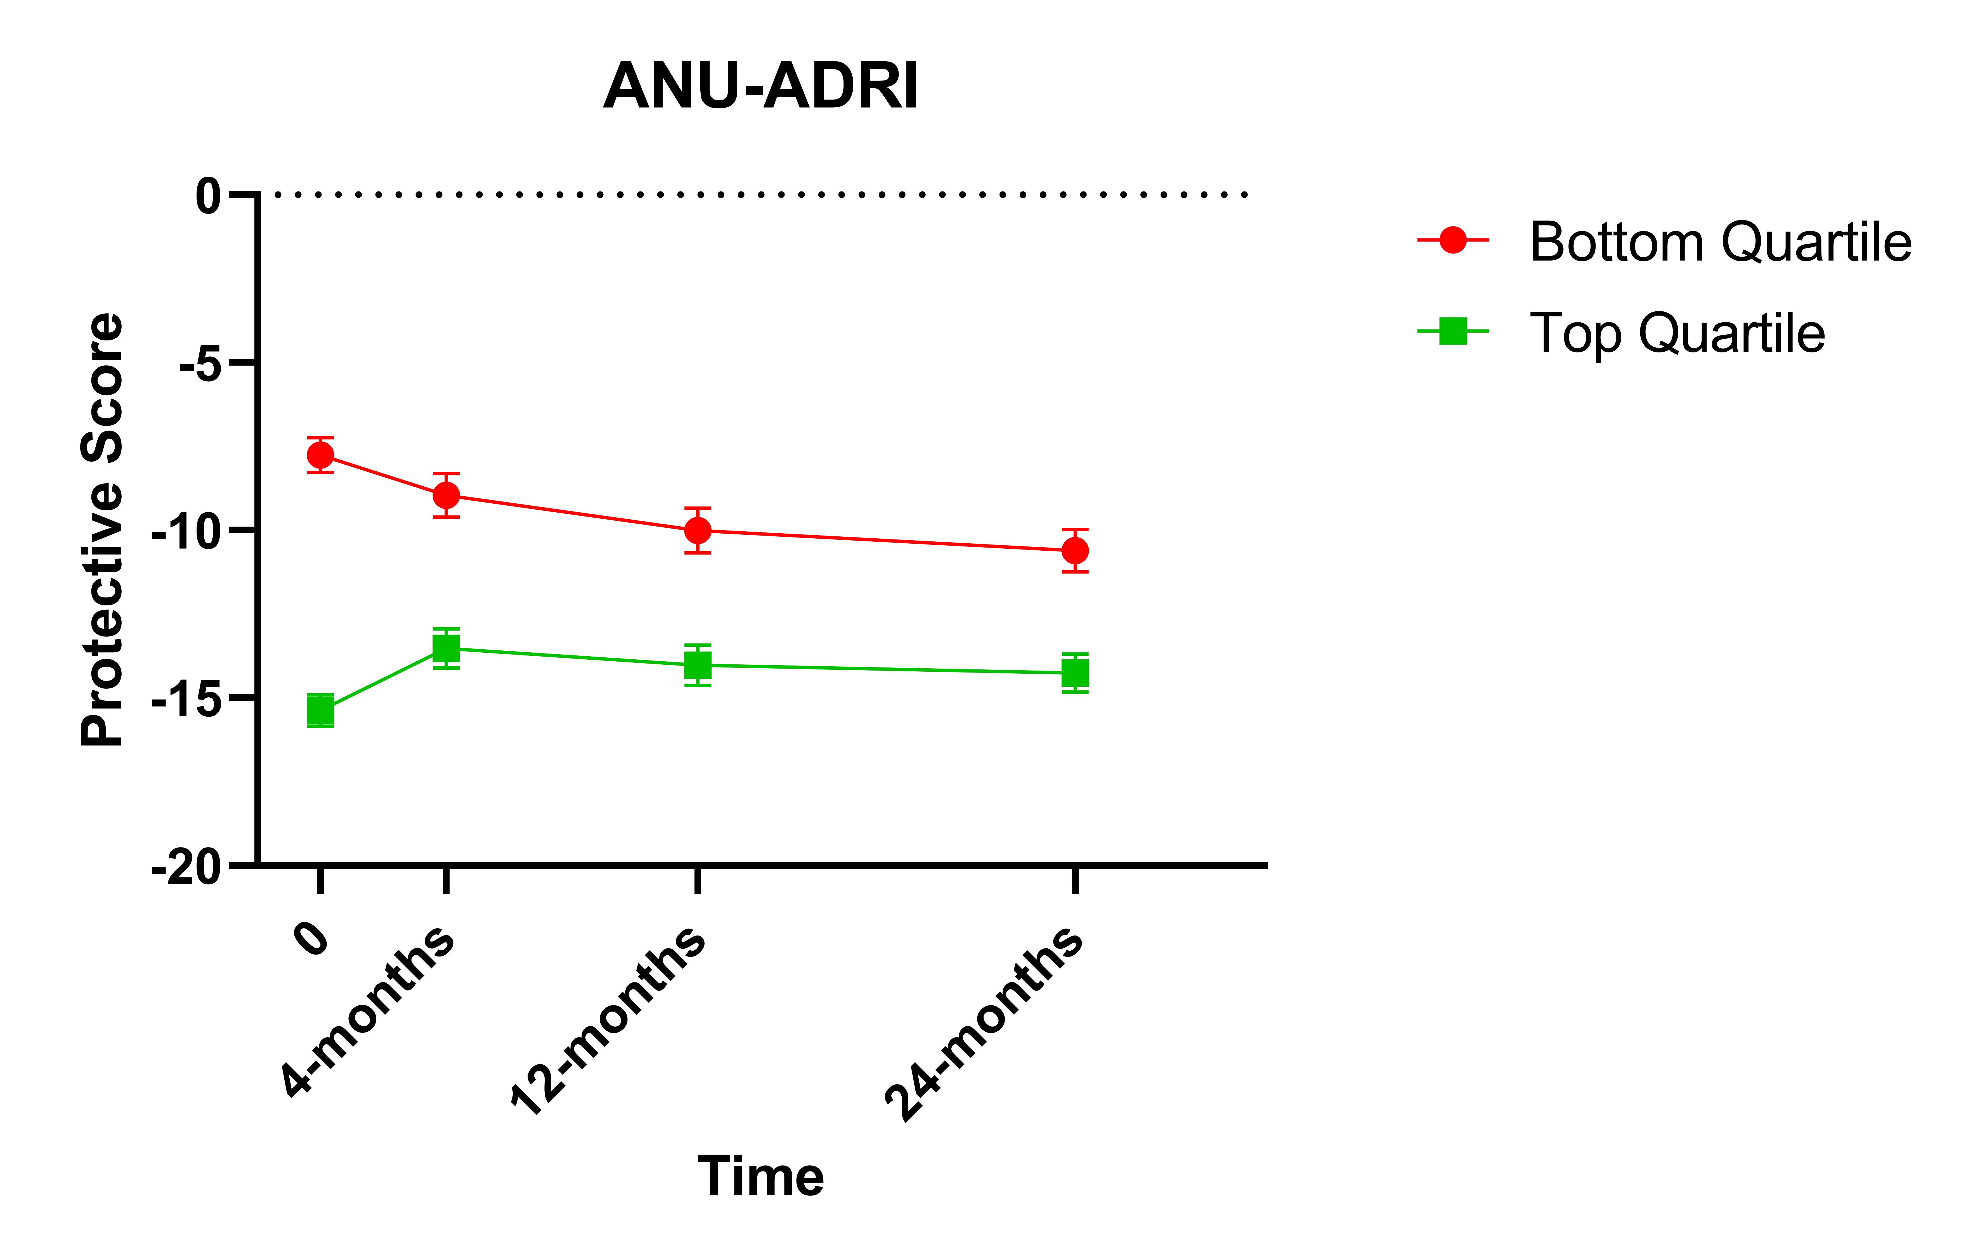
ANU-ADRI by Quartile
*
*

Slide 9
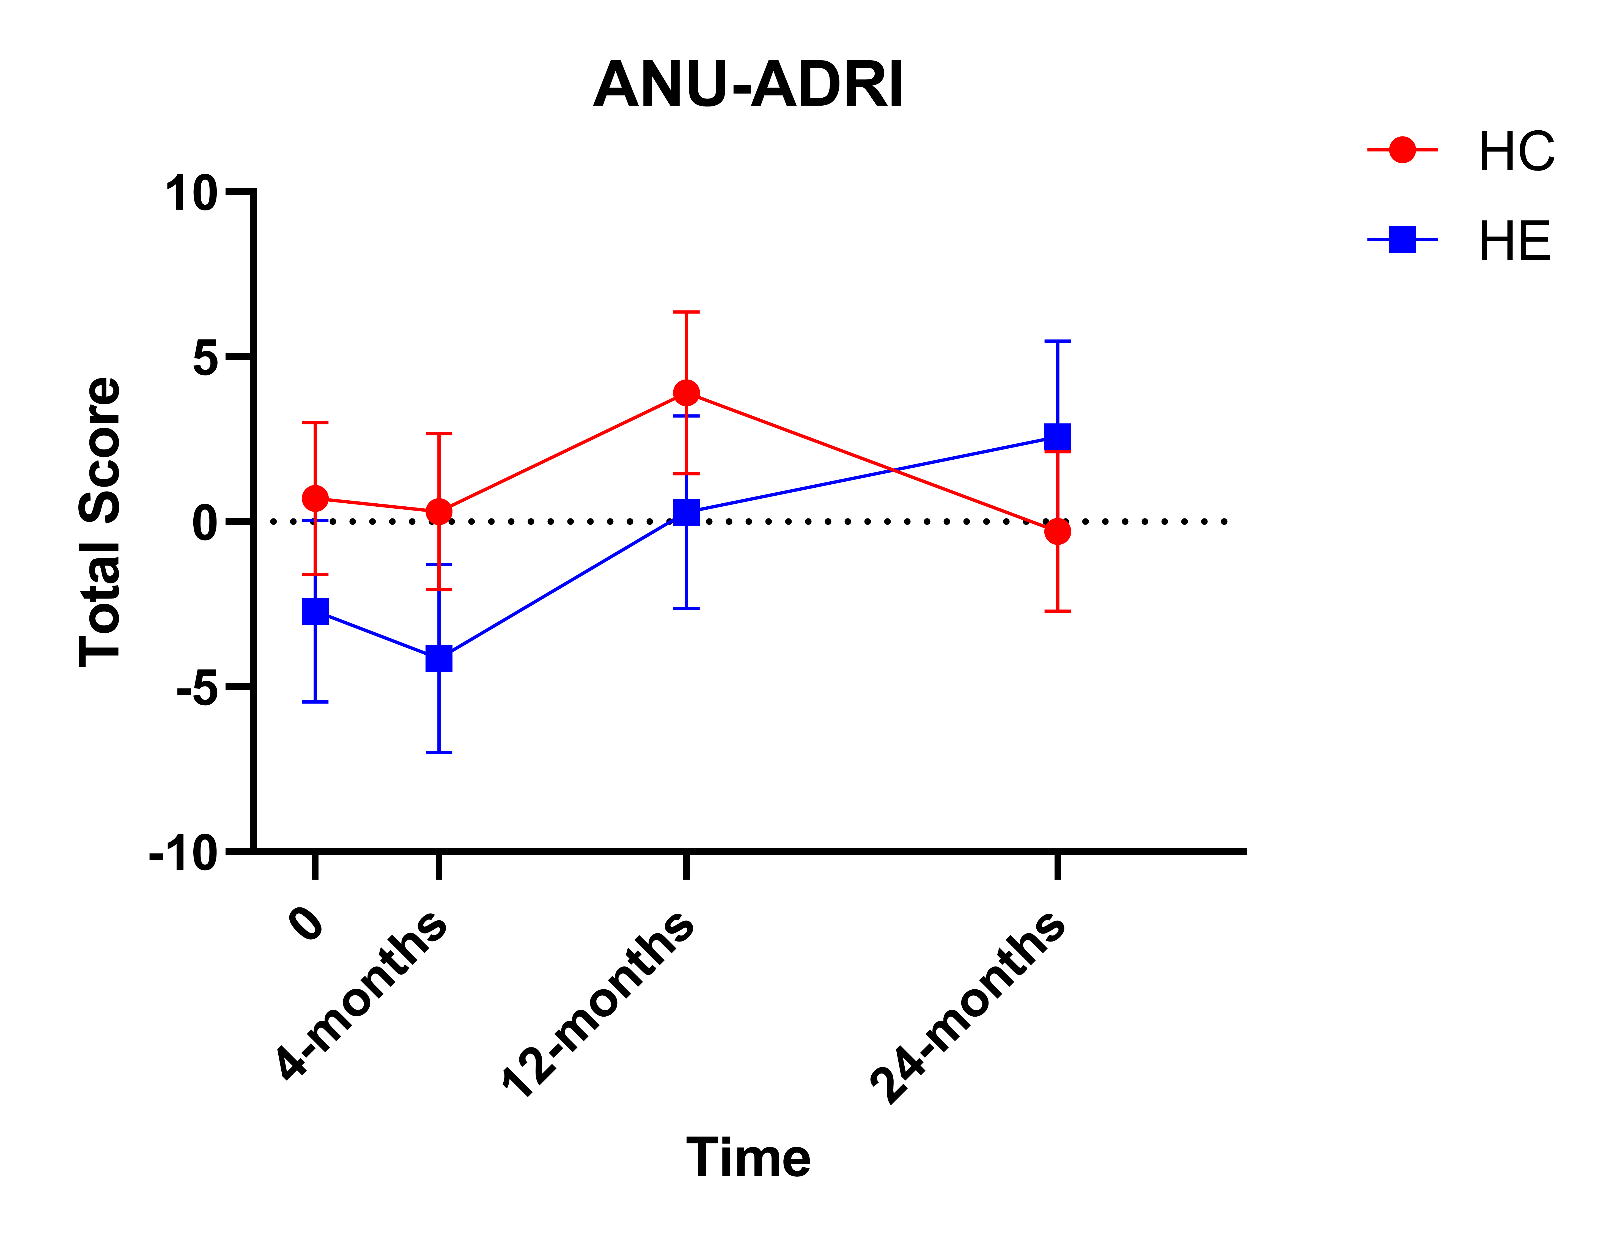
ANU-ADRI Lowest Cognitive Quartile
*

Slide 10

CES-D
Summary:
No change over time
Sex, group, quartile and age cohort had no impact on the analysis

Slide 11
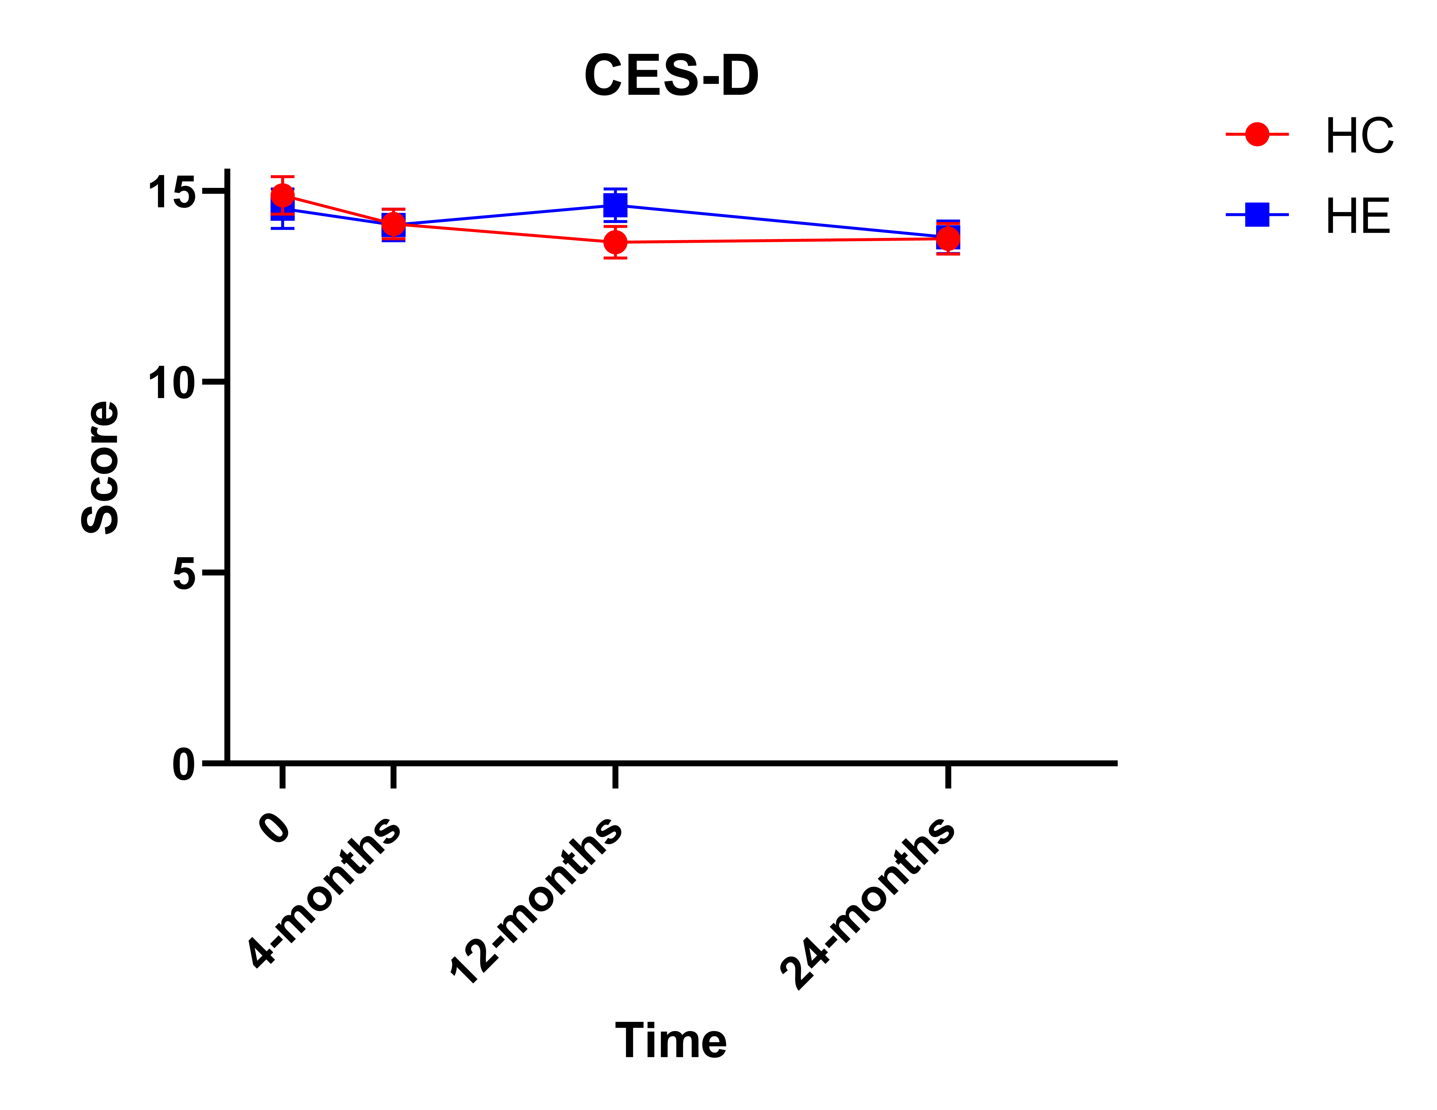
CES-D

Slide 12

SF-12
Summary:
No change over time
Sex, group, quartile and age cohort had no impact on the analysis

Slide 13
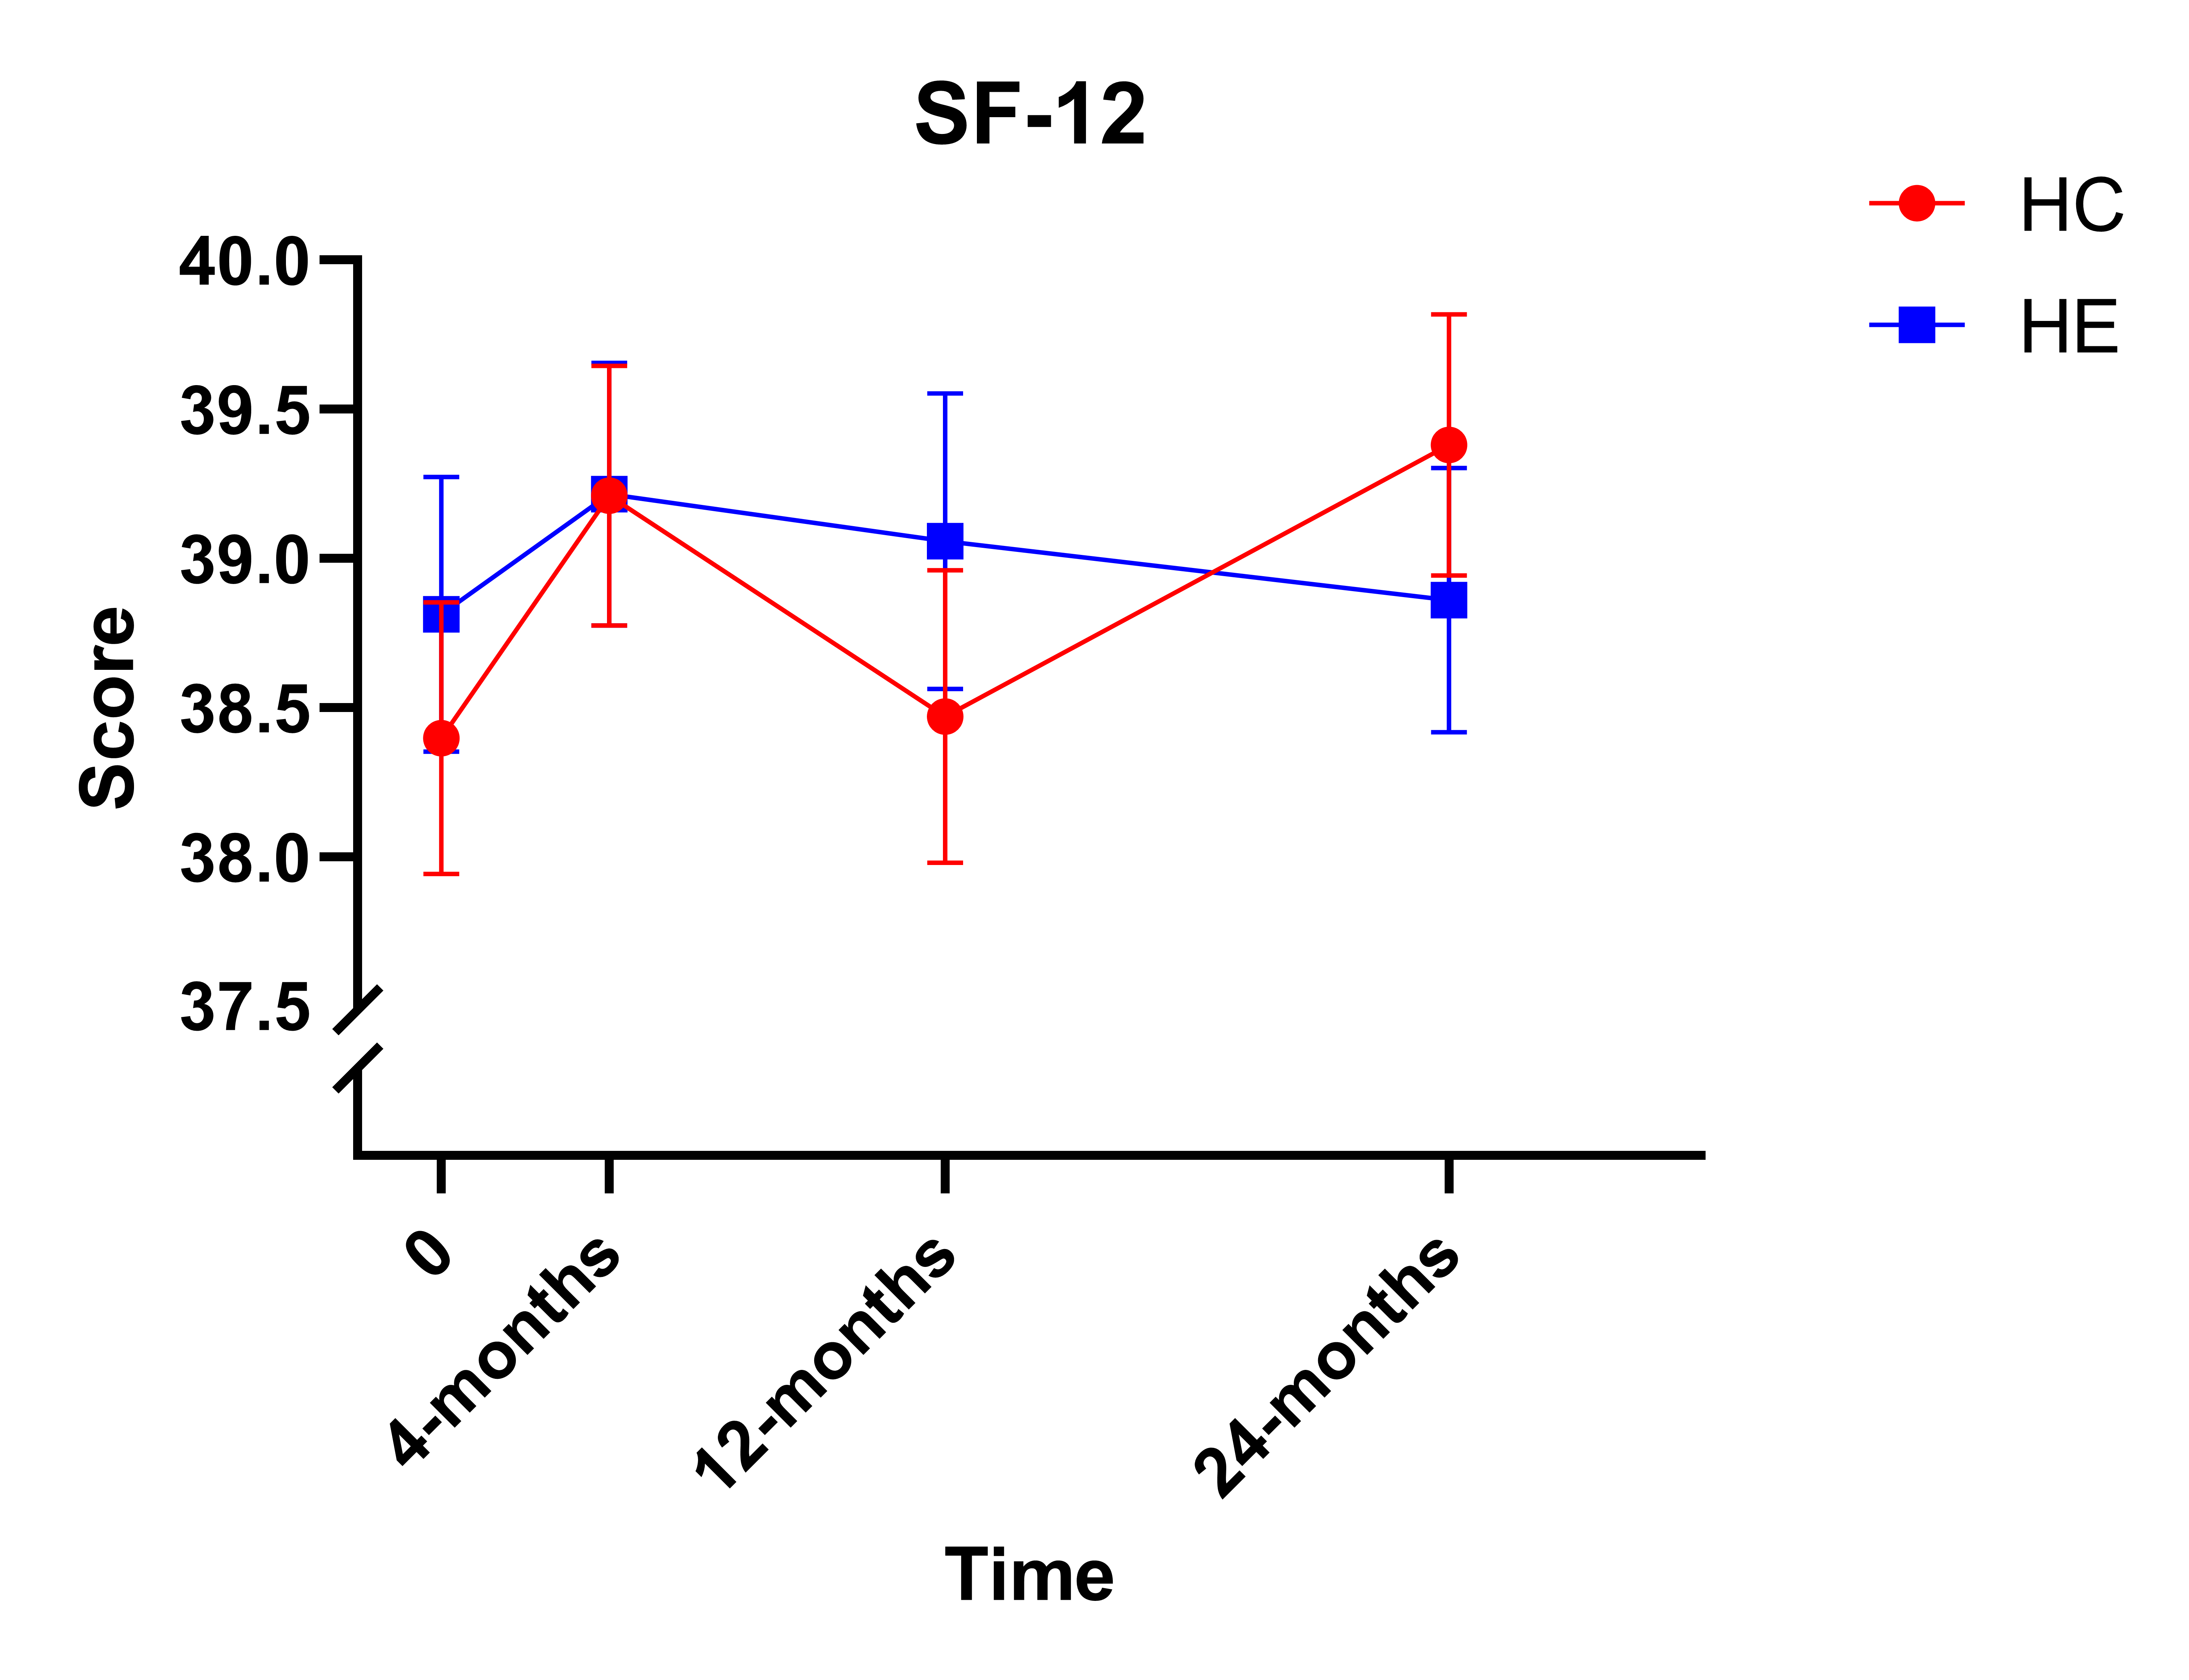
SF-12

Slide 14

PSQI
Summary:
Sleep quality improved over time in the pooled sample
Sex, group, quartile and age cohort had no impact on the analysis

Slide 15
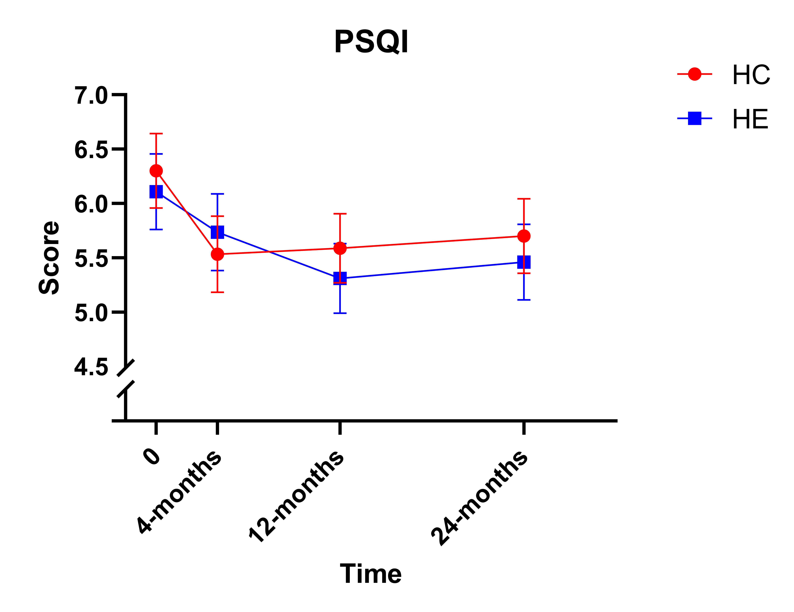
PSQI
*

Slide 16

GAD-7
Summary:
Generalized anxiety improved over time in the pooled sample
Sex, group, quartile and age cohort had no impact on the analysis

Slide 17
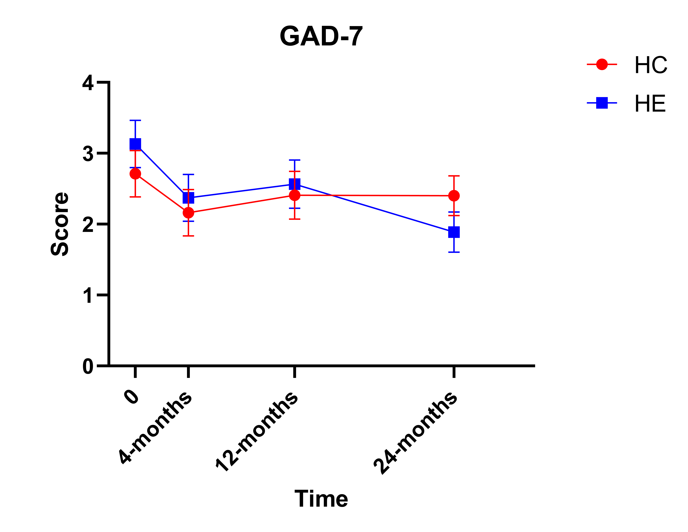
GAD-7
*

Slide 18

Perceived Stress
Summary:
Perceived stress decreased over time in the pooled sample
Sex, group, quartile and age cohort had no impact on the analysis

Slide 19
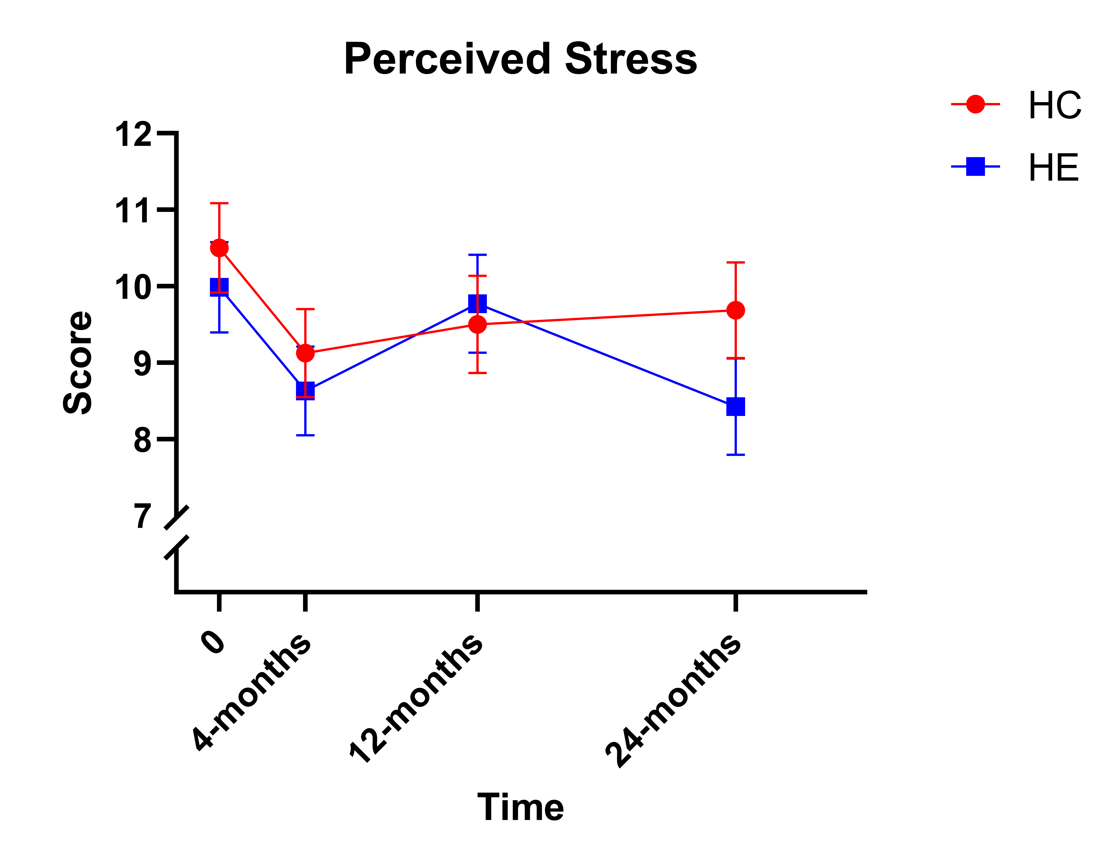
Perceived Stress
*

Slide 20

PHQ-9
Summary:
Depression decreased over time in the pooled sample
Sex, group, quartile and age cohort had no impact on the analysis

Slide 21
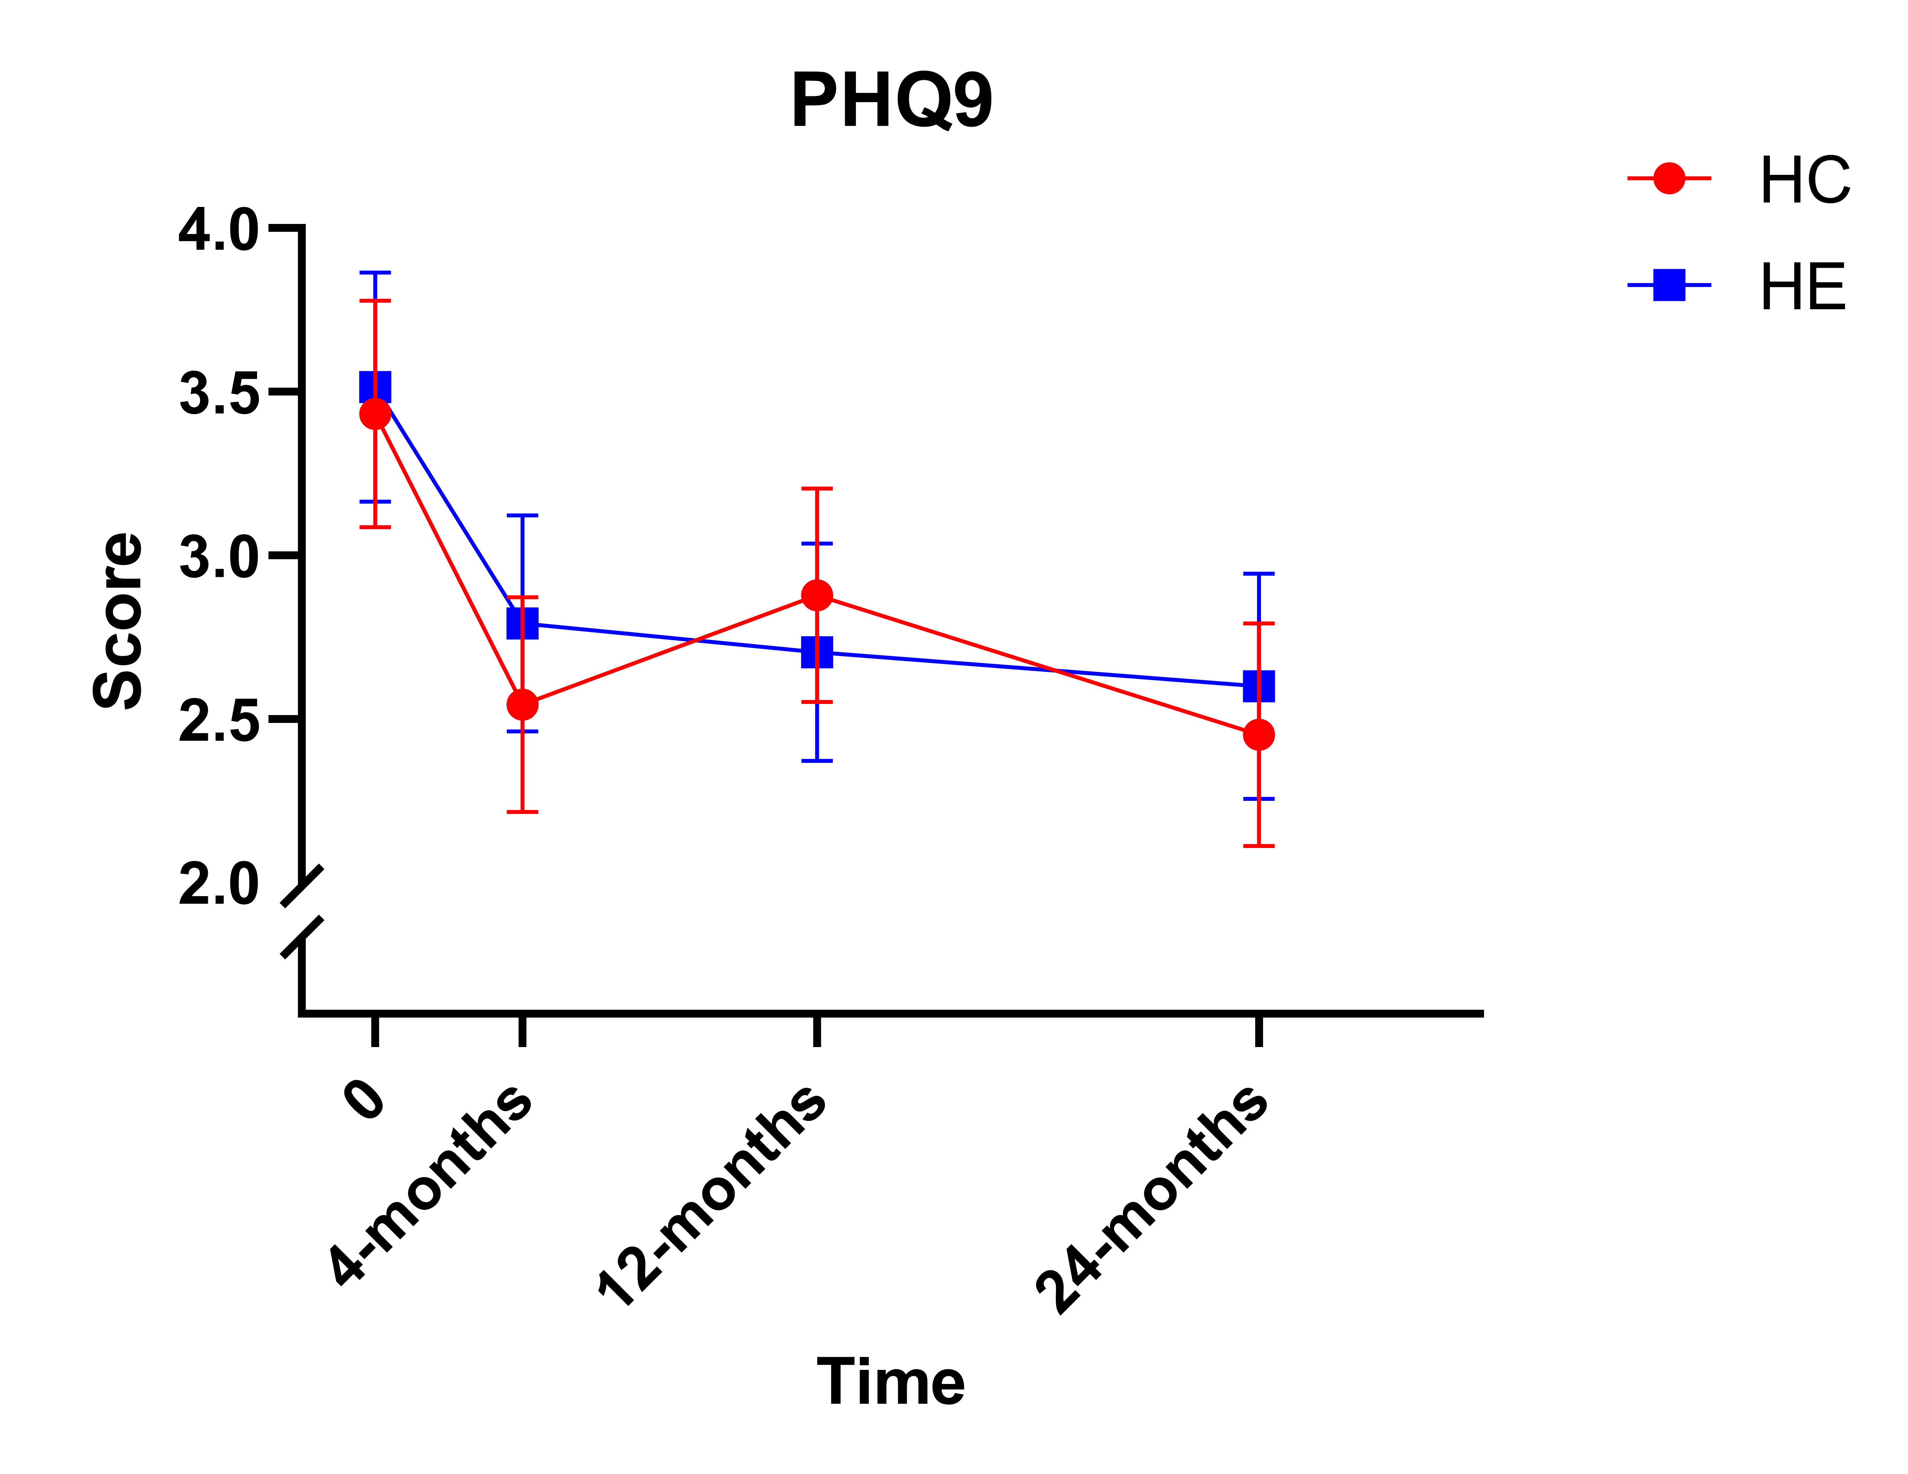
PHQ-9
*

Slide 22

UCLA Loneliness
Summary:
Loneliness improved over time in the pooled sample
HE improved earlier and through the entire duration
Score improvement only occurred in older adults
Sex and quartile had no impact on the analysis

Slide 23
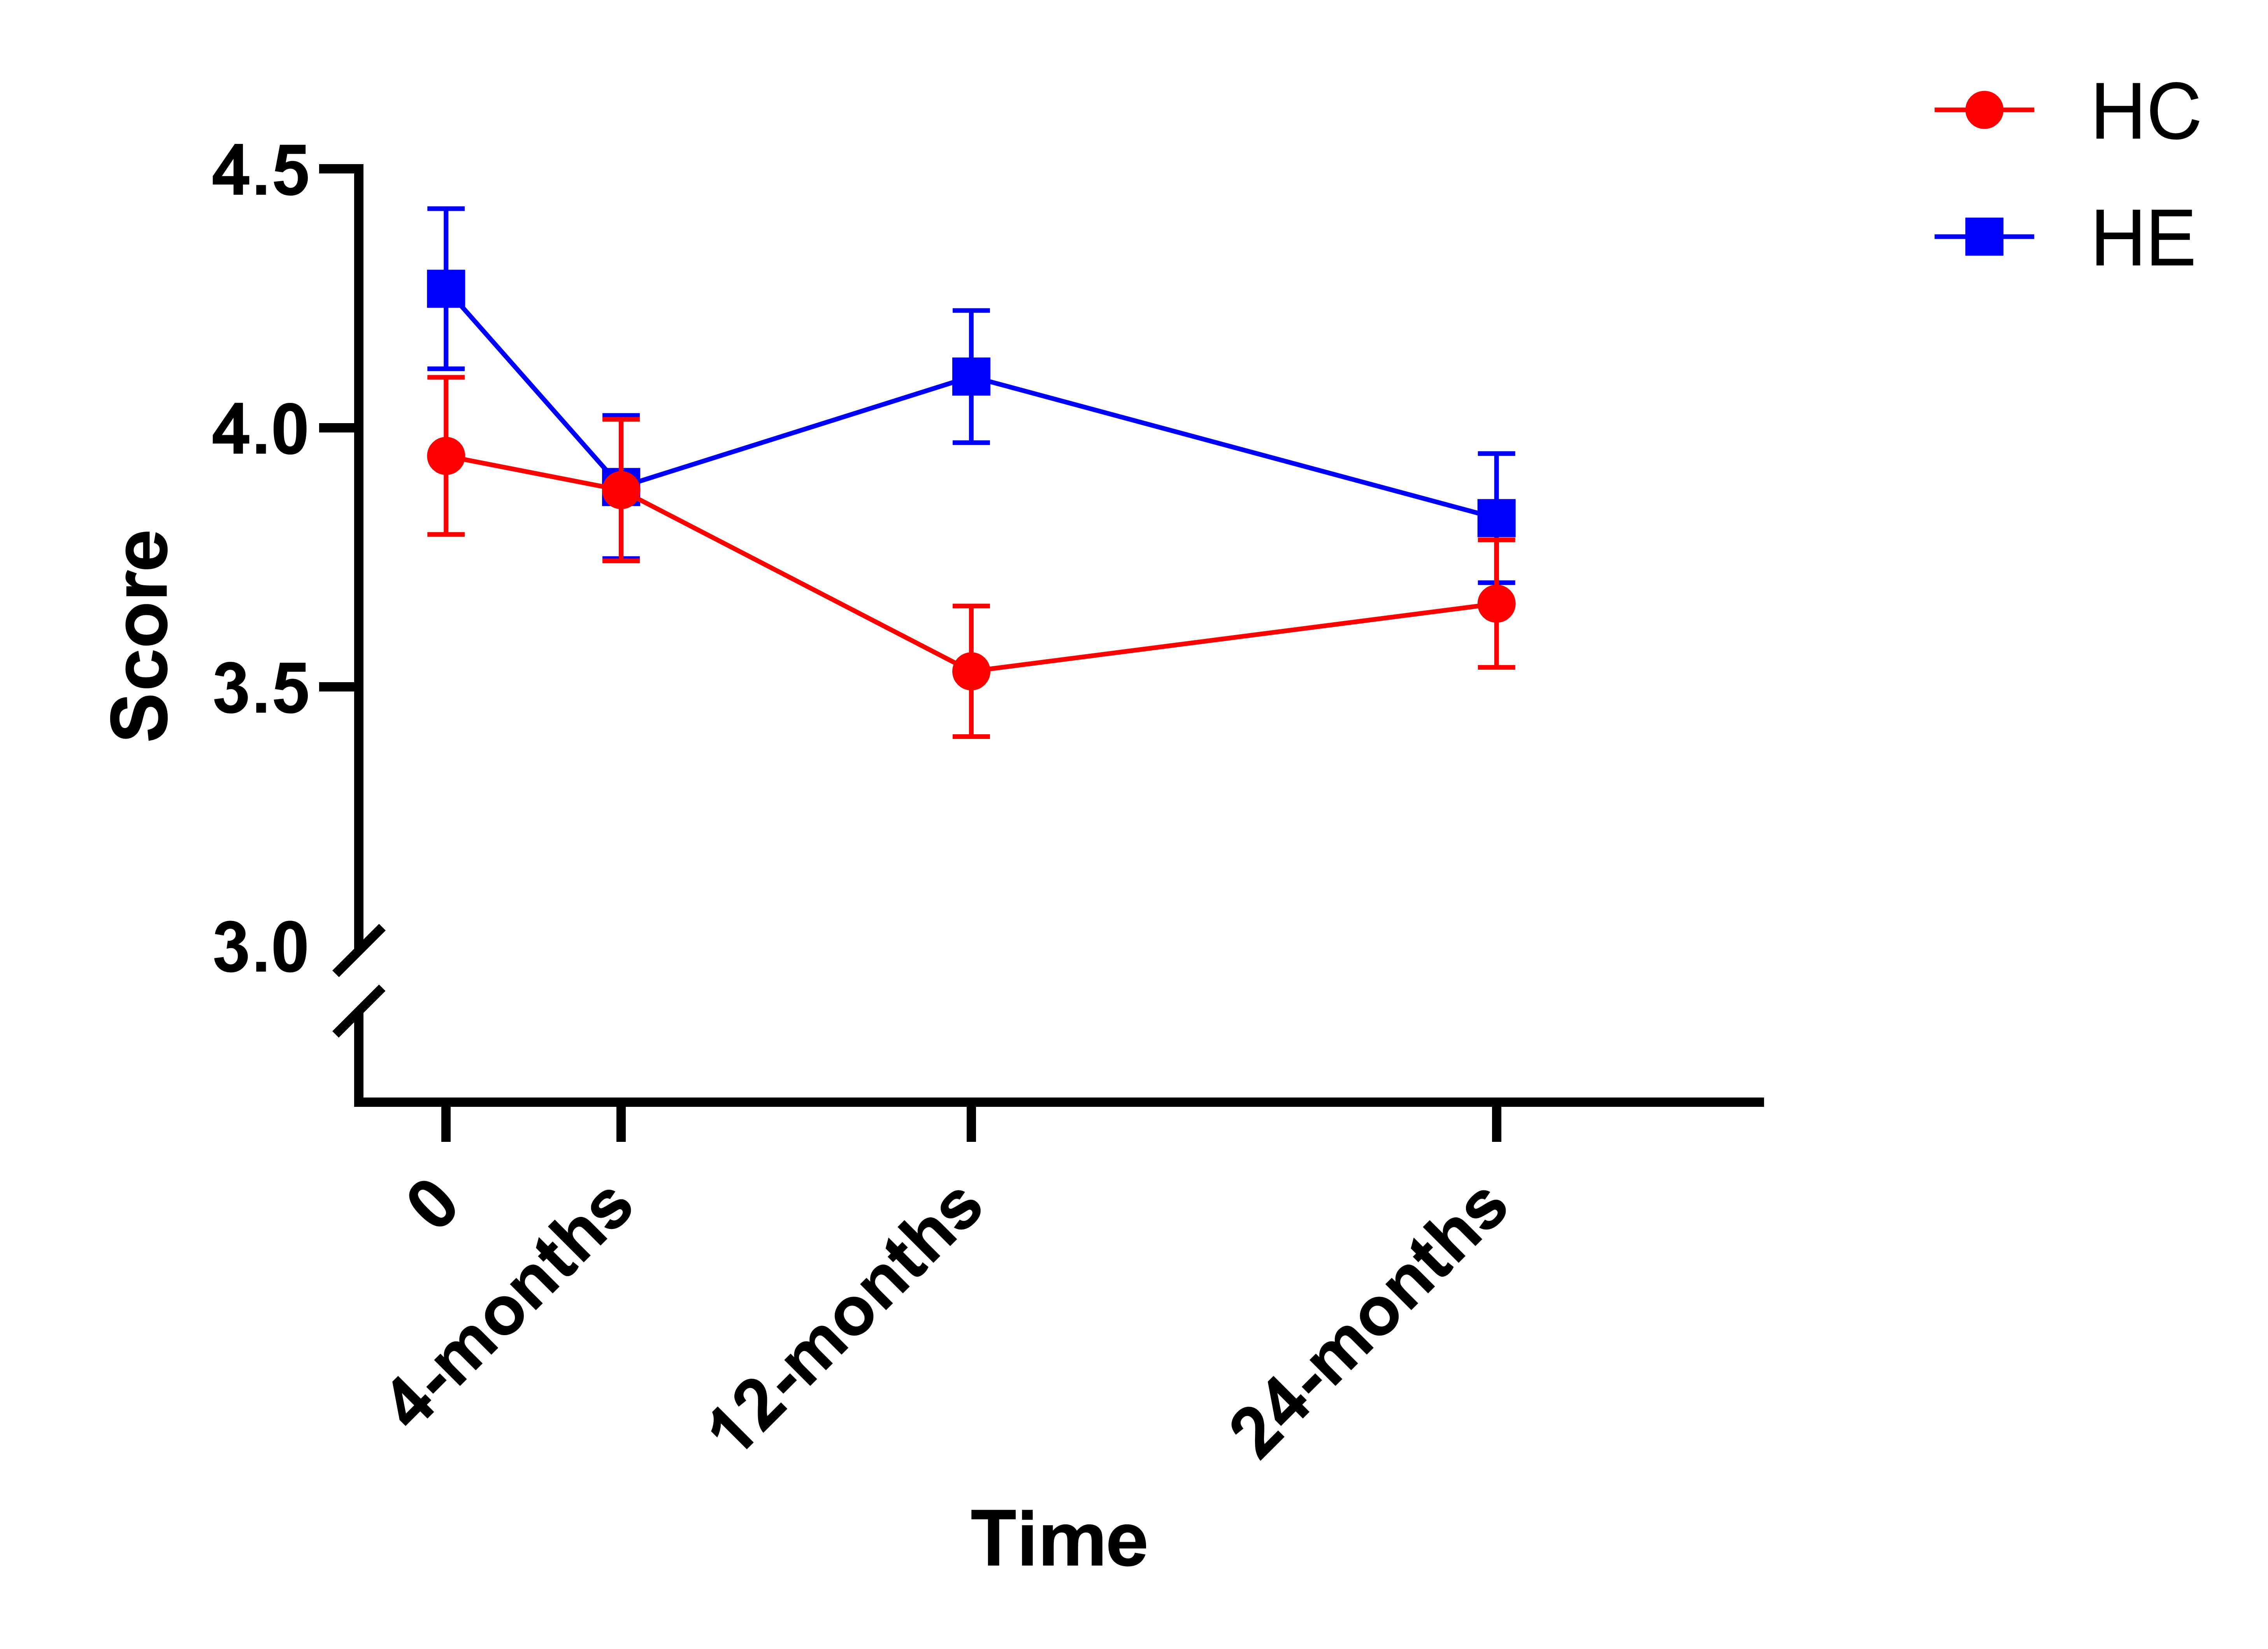
UCLA Loneliness
HE*
HC*

Slide 24
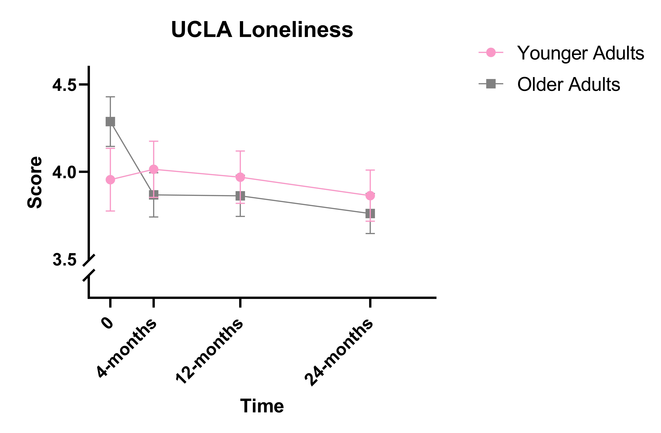
UCLA Loneliness
*

Slide 25




Conclusion
Few outcomes improved past 4 months, and almost none past 12 months
The increased level of AD risk protection witnessed at 4- and 12-months regressed toward the mean
When an outcome improved, HC and HE appeared to be equally effective
Age, sex, and starting cognitive ability had little impact on outcomes

Slide 26

Questions?

Slide 27


Thank you
Anthony Campitelli
amcampit@
uark.edu

